Slide 1

Fundamentals of RM
RM System and Process
Leadership in RM
Incident Investigation
RM Tools & Challenges
RM in Industry
People & Org.
Application and Perspectives
On Becoming a Leader
in Risk Management
ENGG404 - Lecture
Chapter 5.10: What-If Analysis Tool
1

Slide 2
Learning Outcomes:
Explain the What-If Analysis risk analysis technique
Interpret and create a What-If Analysis
Explain the benefits and limitations of the What-If Analysis
Chapter 5.10: What-If Analysis Tool
2
Notes:
2

Slide 3
Introduction
Not so easy, especially if you do NOT know the technology!
What-If Analysis - a well-established and widely used method for identifying and analysing hazards, hazardous events (scenarios), and needed controls.
While originally developed for chemical/petrochemical process hazard analysis (PHA), the tool has become widely used in many other industries.
Can be applied to a system, process, or operation or for a more specific focus such as a piece of equipment, procedure, or activity.
The tool helps uncover potential incidents (proactive), and challenges the team to create and answer questions which reveal potential undesirable consequences.
Chapter 5.10: What-If Analysis Tool
3
Notes:
3

Slide 4
Introduction
A structured brainstorming technique
Hazards are identified by answering questions derived from a review team’s knowledge and experience – “What if …”
    Specific components fail
    Process parameter (flow, level, temperature) are abnormal
    Operator actions are performed incorrectly
    Various external events occur
Can be used in conjunction with relevant checklists
For each question, we evaluate
    the causes
    consequences
    safeguards/controls (in place, assumed)
Recommendations are made when improvements are needed
Chapter 5.10: What-If Analysis Tool
4
Notes:
4

Slide 5
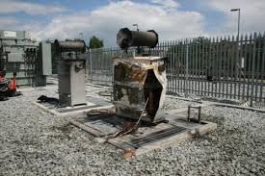
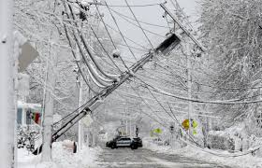
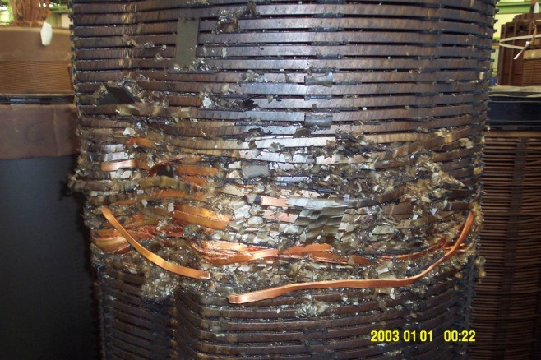
Consider Extreme Events (Low L, High C)
You may never have seen it, but is it possible?
(Extremely Low Likelihood but Extremely High Consequence)
What if we created a vacuum, instead of pressure, on the vessel ?
Chapter 5.10: What-If Analysis Tool
5
Notes:
Burned electrical box, failed transformer, ice storm downed power transmission lines

Slide 6
What-If Analysis Applications
Design safety reviews of new facilities, systems & equipment
    This can be a key input to the “Prevention Through Design Process”, the next topic!
As part of Management of Change (MOC) reviews
Non-routine activities such as equipment installation, repair or decommissioning
Facilities / Operations that manage (store, handle, processhazardous processes, materials
“Table Top Drills” to review emergency scenarios & necessary measures for preparedness, disaster recovery & business interruption
Chapter 5.10: What-If Analysis Tool
6

Slide 7

Steps in What If Analysis
Define purpose and scope
  What is being analyzed?
  What risk criteria will be used? (the acceptable level of risk)
Assemble team
  Technical experts, safety experts in different areas
  End users if possible
Let’s examine these two steps …
Communicate objectives
  Does everyone on the team know what the purpose and scope is? How are the risk criteria defined?
Gather information
  Drawings, schematics, component specs, operating manuals, reference manuals, etc
Breakdown into tasks
  Break down the activity/system into tasks/elements to be analyzed
Generate What-If Analysis questions
  Brainstorm hazards and hazardous scenarios with team
Answer What-If Analysis questions
  Discuss the causes, resulting consequences, existing/assumed controls/safeguards
Select additional controls
  Identify and select risk reduction controls (using hierarchy of controls)
Communicate results
  Communicate analysis results & recommendations for controls to decision makers
Chapter 5.10: What-If Analysis Tool
7
Notes:
7
Risk criteria are used to determine whether a specified level of risk is acceptable or tolerable

Slide 8

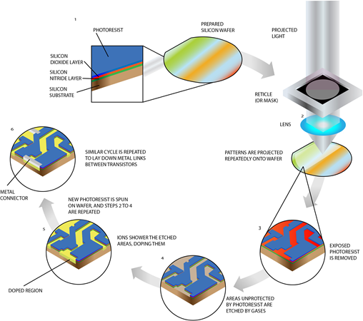
Semiconductor Fabrication
What are the hazards?
  Gases e.g. argon, carbon dioxide, oxygen, nitrogen
  Electrostatic discharge (from machinery)
  Acids such as acetic, chromic, hydrochloric, hydrofluoric, nitric, phosphoric, and sulfuric
  Caustics such as ammonium hydroxide, hydrogen peroxide, and sodium hydroxide
  Other gases which are corrosive, explosive, flammable, pyrophoric and/or toxic such as arsine, boron trifluoride, diborane, hydrogen chloride, phosphine, and silane
  Ionizing and nonionizing radiation such as infrared (IR), lasers, radiofrequency (RF), and x-rays
  Metals & salts such as aluminum, antimony, arsenic, boron, chromium, gallium, gold, magnesium, mercury, nickel, silver, and phosphorus
  Nanoparticles
  Nuisance dust
  Silica (crystalline) and silicon such as polycrystalline silicon, silicon dioxide, and silicon nitride;
  Solvents such as acetone, ethanol, glycol ether mixture, etc.
Chapter 5.10: What-If Analysis Tool
8

Slide 9
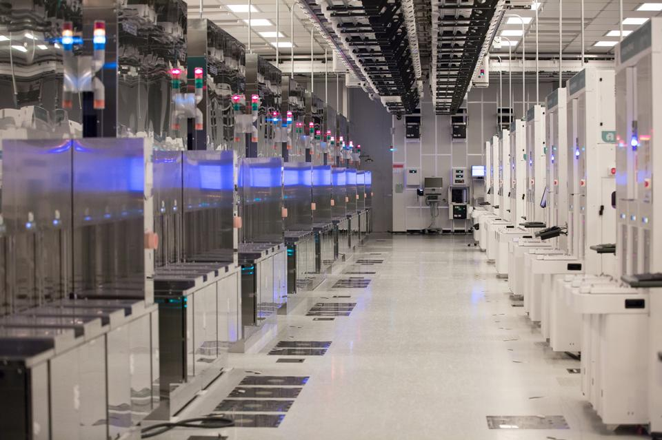
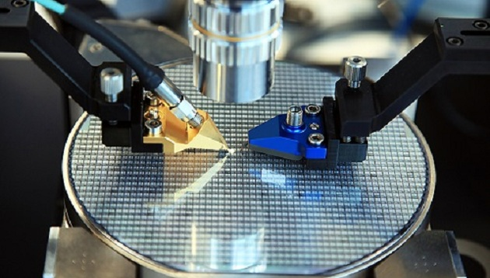
Example: WIA on Semi-conductor Manufacturing
Let’s suppose you asked the question:
What if the pneumatic lines pressured with nitrogen leaked?
Identify the consequences:
The nitrogen would escape into the surrounding environment and possibly asphyxiate workers.
(In high concentrations, N2 is an asphyxiant.)
Then, specify the action(s) of any existing safeguards/controls
None; so what does this mean for risk level? Is it acceptable?
Chapter 5.10: What-If Analysis Tool
9

Slide 10
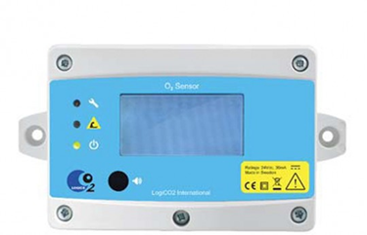


Suggest Improvements / Alternatives To Lower Risk
Think about ways to reduce the likelihood of the initiating event (prevention):
  Consider using a gas other than nitrogen in the pneumatic lines
Think about ways to mitigate the consequences of the hazardous event:
  Consider installing oxygen sensors with low O2 alarms in work areas
Think about ways to facilitate worker response:
  Consider providing personnel with respirators in work areas
Chapter 5.10: What-If Analysis Tool
10

Slide 11
What-If Analysis Table For Hazardous Scenarios
Area of Concern | What If… | Hazard | Cause | Consequence | Safeguard In Place | Recommendation
Pneumatic lines utilizing nitrogen or carbon dioxide | The lines leak inside the facility | Toxicity of gas | Over-pressurization, tube defects, loose connections | Gas leaks, asphyxiating workers in area | None | Install oxygen sensors; consider less toxic gas; make respirators available
Process venting of silane | Silane immediately ignites, or delayed vapour cloud ignition | Flamm-ability of gas | Spark or short circuit from handling equipment | Workers injured or killed, infrastructure damaged | Residual venting of area during container changes, double glass walls for separation | Install pressure relief valves for emergency venting
Radio-frequency radiation used in induction heating | RF radiation exceeds recommended/ safe exposure levels | Radiation | Malfunctioning equipment during backside metallization | Workers exposed to RF radiation develop cancer or reduced fertility | PPE | Enclose operations involving RF emissions; provide shielding as necessary
Assumed/existing safeguards? Auditing/confirmation of safeguards?
Chapter 5.10: What-If Analysis Tool
11
Notes:
11

Slide 12
Sample What-If Analysis Template with Risk Matrix
Date: Process and Location: Topic Investigated: Equipment / Task Intentions:
Area of Concern | What If… | Hazard | Cause | Consequence | Risk Level | Safeguard In Place | Recommendation | Residual Risk Level
Chapter 5.10: What-If Analysis Tool
12
Notes:
12

Slide 13
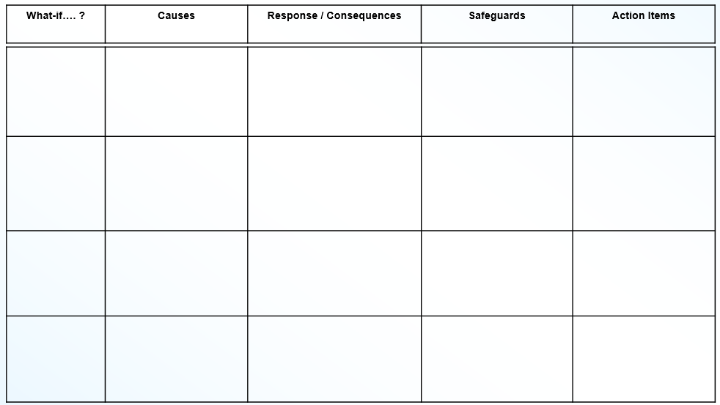
Sample What-If Analysis Template w/o Risk Matrix
Date: Process and Location: Topic Investigated: Equipment / Task Intentions:
Chapter 5.10: What-If Analysis Tool
13
Notes:
13

Slide 14
What-If Analysis Benefits:
Flexible - concept phase to detailed design phase
Can examine non-process issues (e.g. work practices, Human Factors)
Can use the technique to focus on critical “problem” areas and spend less time on areas of low concern
Technique is easy to learn (people with plant / operations experience, not necessarily expertise in the What-If Analysis process, can be readily engaged and contribute)
Generates creativity & new ideas
Recognized technique accepted by many regulatory authorities (due diligence)
Excellent tool for creating “inputs” to the “Prevention Through Design Process”
Chapter 5.10: What-If Analysis Tool
14

Slide 15
What-If Analysis Limitations:
Completeness depends on the questions selected
Quality of review depends on team experience
May miss some hazards
Not always applicable to new or novel processes
Requires high level of team self-discipline to produce a thorough study
Difficult to audit for thoroughness
Chapter 5.10: What-If Analysis Tool
15
Notes:
Are the ‘right’ questions being asked?
You may not know the questions to ask with a new process, product

Slide 16
Summary
What-If Analysis is commonly used to identify potential design, process, or operational hazards in a structured manner
When to use the tool:
  During a broad review of process design and operational scenarios
  On projects when P&IDs are in development (early/preliminary design)
  During a design review by experienced personnel
What-If Analysis strengths:
  Can apply to a system at any point in its life cycle
  Allows focus on areas are greatest concern
  Can address non-process issues
  Use an input to a design process, such as “Prevention Through Design”
What-If Analysis weaknesses:
  Requires sufficient experience to ask key questions
  May not be best for new equipment or technology
  Potential for less rigorous analysis
Chapter 5.10: What-If Analysis Tool
16
Notes:
16

